Slide 1
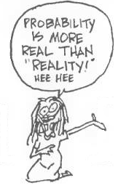
Binomial Distribution
Chapter 4 Part 2
Dr. Abolfazl Saghafi
Assistant Professor of Statistics & Data Science
Data Science Program Director
Notes:
Aftermath of a shitty storm!

Slide 2
Bernoulli Experiments
S
Failure
Lose
Success
Win
The sample space of an experiment is partitioned into two parts, calling them Success and Failure where
P(Success) = p
S = {Success, Failure}
Rx = {1, 0}
We do this experiment only once and define RV X as the number of success, then the PMF of X would be
This PMF can be written in a closed form as
The RV X with the given PMF is called a Bernoulli RV, we write it as
X ~ Ber(p)
prob
prob
prob
3/4
1/2
Read as
X is distributed Bernoulli with parameter p
1/4
0
1
0
1
0
1
p=0.25
p=0.5
p=0.75
Notes:
The most simple discrete probability distribution and here is how we define it
This distribution is the mother of many discrete PMF

Slide 3
Example
S
Success
Answer
Correctly
Failure
Answer
Incorrectly
A student is selecting answer of a multiple choice question, four options with one correct answer, at random.
Let X denotes the result of this experiment, identify the PMF of X and find the E(X) and Var(X).
X ~ Ber(p)
E(X) = p
q = 1-p
Var(X) = p q
Notes:
Step1. S = {Lose, Win} Step2. Rx = {0, 1} Step3. p(0)=3/4, p(1)=1/4
From this configuration, we can tell that X ~ Ber(¼)
E(X)=(0*3/4)+(1*1/4)= ¼ E(X²)=(0²*3/4)+(1²*1/4)= ¼
Var(X)=E(X²)-(E(X))²= ¼-(¼)²= ¼*¾

Slide 4

Example
S
Failure
No Goal
Success
Goal
You are throwing a basketball toward net. If X denotes the result of throwing the ball one time, generate its PMF. Suppose you score on average once out of three shoots.
Some more examples of Bernoulli experiments:
• Fishing, attempt to catch a fish with one rod
• Beer Pong
• Passing ST310
• Crossing the street
• Add a few more …
Notes:
P({Goal}) = ⅓ → P({No Goal}) = ⅔
From this configuration, we can tell that X ~ Ber(⅓)
Either compute the E(X) and Var(X), or use the formula
E(X) = ⅓ Var(X) = ⅓ (⅔)

Slide 5
Binomial Distribution
S
Success
Win
p
Failure
Lose
q
Suppose we repeat a Bernoulli experiment “n” times independently and define RV X as the number of Success in n trials
then X has the following PMF
Rx = {0, 1, 2, …, n}
If the RV X has the given PMF, then X is distributed as Binomial, we write it as X ~ Bin(n, p)
p(X=x)
Probability of having
x Success (n-x) Failure
Notes:
Add this formula to your formula sheet and make sure you write it down correctly

Slide 6
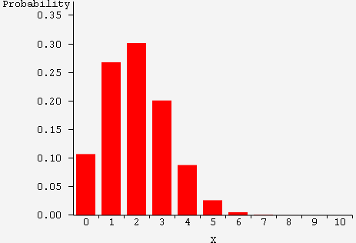
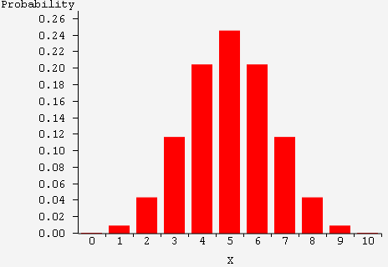
Formula Breakdown
X ~ Bin(n, p)
E(X) = np
Var(X) = npq

Slide 7
Example
You are selecting the answers of a test with 20 multiple choice questions, four choices, at random. What is the prob that
you get exactly 10 of the answers right?
you get at most 5 answers right?
you have at least 8 correct answers?
How many do you expect to answer correctly?
Notes:
Try modeling this the same way we did the Binomial experiments, start with the basics
d) The expected number is the expected value or mean of the distribution which is
E(X)= n*p= 20*0.25= 5
So, we expect that you answer 5 questions correctly on average.

Slide 8

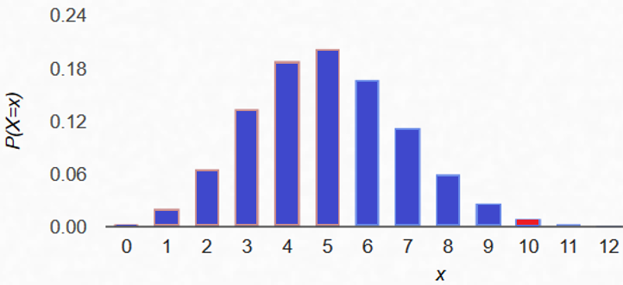
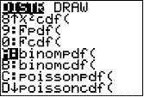
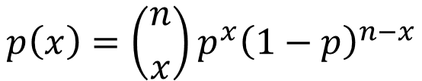
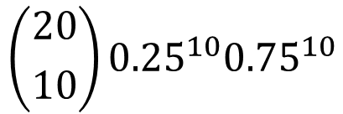

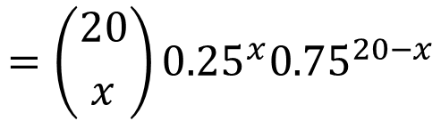
Answer
X: the total number of Correct answers ~ Bin (n=20, p=0.25)
$$p\left(x\right)=\left({n \atop x}\right)p^{x}{\left(1−p\right)}^{n−x}$$
$$=\left({20 \atop x}\right){0.25}^{x}{0.75}^{20−x}$$
$$x=0, 1, …, 20$$
$$\left({20 \atop 10}\right){0.25}^{10}{0.75}^{10}$$
a) P(X=10) =
The prob of 10 correct 10 incorrect answers
Press 2nd VARS [DISTR]
Scroll down to
A: binompdf(
Press ENTER.
Enter 20,0.25,10)
and press ENTER
to get the answer 0.00992
Notes:
For each question, either we select the correct answer or we don’t, there are two outcomes with chance of winning (correct answer) equal to p=1/4 since there are four options in each multiple choice question. There are 20 such questions and we are selecting their answer randomly. Therefore, if RV X represent the total number of Correct answers, then X ~ Bin (20, 0.25). It’s PDF is known and we can use it to answer any probability questions regarding this experiment.

Slide 9
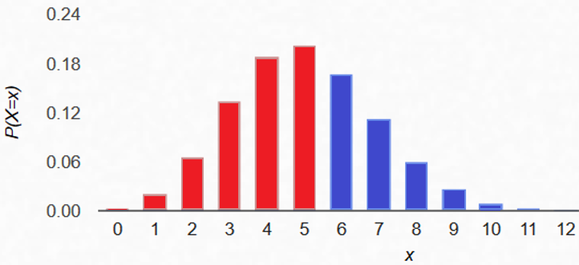
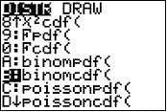
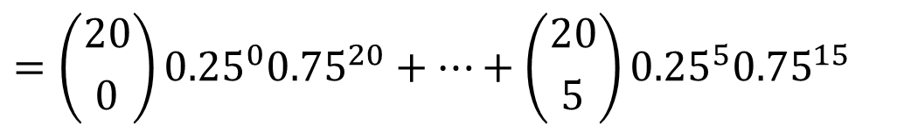
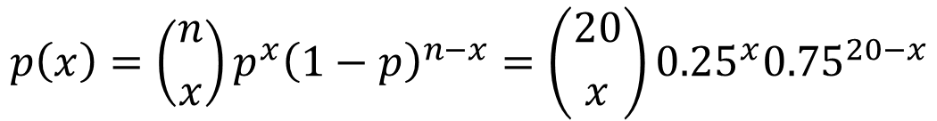
Answer
X: the total number of Correct answers ~ Bin (n=20, p=0.25)
$$p\left(x\right)=\left({n \atop x}\right)p^{x}{\left(1−p\right)}^{n−x}=\left({20 \atop x}\right){0.25}^{x}{0.75}^{20−x}$$
$$x=0, 1, …, 20$$
= p(0)+p(1)+p(2)+p(3)+p(4)+p(5)
The prob of at most 5 correct answers
b) P(X ≤ 5)
$$=\left({20 \atop 0}\right){0.25}^{0}{0.75}^{20}+…+\left({20 \atop 5}\right){0.25}^{5}{0.75}^{15}$$
Press 2nd VARS [DISTR]
Cumulative Probability
Scroll down to
A: binomcdf(
Press ENTER.
Enter 20,0.25,5)
and press ENTER
to get the answer 0.61717

Slide 10
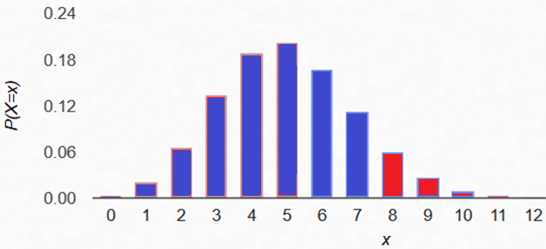

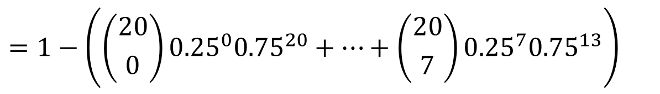
Answer
X: the total number of Correct answers ~ Bin (n=20, p=0.25)
$$p\left(x\right)=\left({n \atop x}\right)p^{x}{\left(1−p\right)}^{n−x}=\left({20 \atop x}\right){0.25}^{x}{0.75}^{20−x}$$
$$x=0, 1, …, 20$$
c) P(X ≥ 8)
= p(8)+p(9)+…+p(20) = 1 – P(X ≤ 7)
The prob of at least 8 correct answers
$$=1−\left(\left({20 \atop 0}\right){0.25}^{0}{0.75}^{20}+…+\left({20 \atop 7}\right){0.25}^{7}{0.75}^{13}\right)$$
$$=1−0.89819$$
Press 2nd VARS [DISTR]
Scroll down to
A: binomcdf(
Press ENTER.
Enter 20,0.25,7)
and press ENTER
to get the answer 0.89819

Slide 11
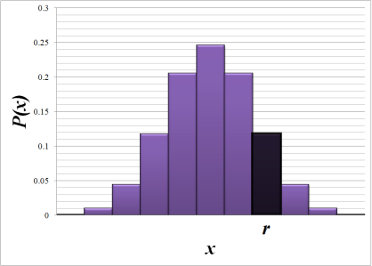
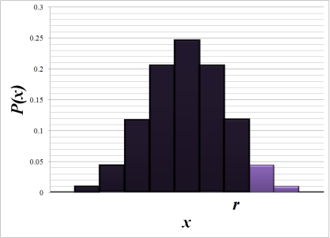
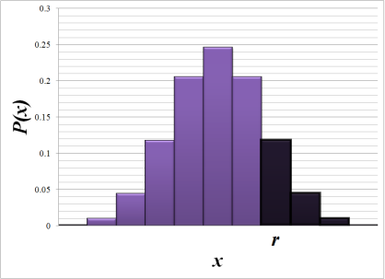



Heads Up
Pay attention to these expressions and what they mean
Exactly
At Most
At Least
This can be computed using calculator and binomPDF function
This can be computed using calculator and binomPDF AND binomCDF function
This can be computed using calculator and binomPDF AND binomCDF function (needs adjustments)

Slide 12
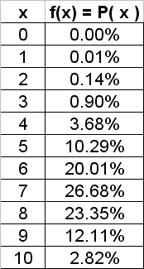
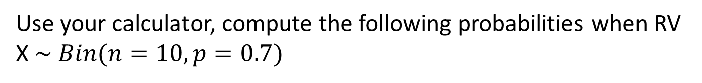



Example
Use your calculator, compute the following probabilities when RV X $\sim Bin(n=10, p=0.7)$
$$P\left(X=7\right)$$
$$P\left(X≥7\right)$$
$$P\left(X≤2\right)$$
Notes:
p(7)= binomPDF(10, 0.7, 7)= 0.2668
P(X≥7)= 1-P(X≤6)= 1-binomCDF(10, 0.7, 6)= 0.6496 Or
P(X≥7)= p(7)+p(8)+p(9)+p(10)= binomPDF(10,0.7,7)+binomPDF(10,0.7,8)+binomPDF(10,0.7,9)+binomPDF(10,0.7,10)= 0.6496
P(X≤2)= binomCDF(10, 0.7, 2)= 0.0015 Or
P(X≤2)= p(0)+p(1)+p(2)=binomPDF(10, 0.7, 0)+binomPDF(10, 0.7, 1)+binomPDF(10, 0.7, 2)=0.0015

Slide 13
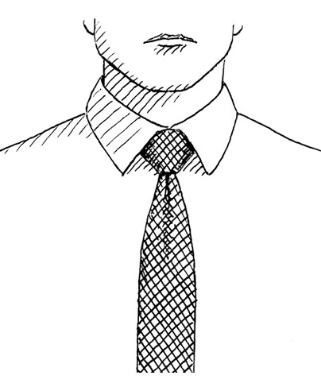
Example
A research team at Cornell University conducted a study showing that approximately 67% of all businessmen who wear ties, wear them so tight that they actually reduced blood flow to the brain.
At a board meeting of 10 businessmen, all of whom wear ties, what is the probability that
At least one tie is too tight?
More than two ties are too tight?
No tie is too tight?
At least 8 ties are not too tight?

Slide 14
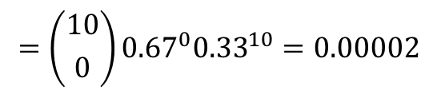
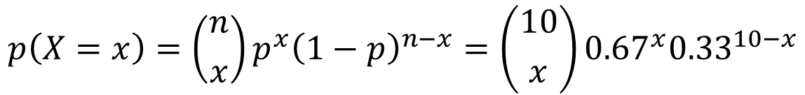

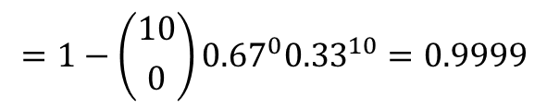


S
If we define RV X as the number of people in a group of 10 who wear the tie too tight, then the setting of the experiment suggests that X ~ Bin(10, 0.67) with
No
Wear too
tight
p=0.67
$$p\left(X=x\right)=\left({n \atop x}\right)p^{x}{\left(1−p\right)}^{n−x}=\left({10 \atop x}\right){0.67}^{x}{0.33}^{10−x}$$
$$x=0, 1, …, 10$$
a) At least one tie is too tight?
P(X ≥ 1) =
1 - P(X < 1) = 1 - P(X = 0)
$$=1−\left({10 \atop 0}\right){0.67}^{0}{0.33}^{10}=0.9999$$
$$=1−binomPDF(10,0.67,0)=0.9999$$
b) More than two ties are too tight?
P(X > 2) =
1 - P(X ≤ 2)
= 1 – p(0) – p(1) – p(2)
$$=1−binomPDF\left(10,0.67,0\right)−binomPDF\left(10,0.67,1\right)−binomPDF(10,0.67,2)=0.9968$$
c) No tie is too tight?
d) At least 8 ties are NOT too tight?
P(X = 0)
$$=\left({10 \atop 0}\right){0.67}^{0}{0.33}^{10}=0.00002$$
→ at most 2 are too tight?
P(X ≤ 2)
$$=0.00317$$
Notes:
Answer
P(X ≤ 2)= $binomCDF\left(10,0.67,2\right)$= $0.00317$

Slide 15
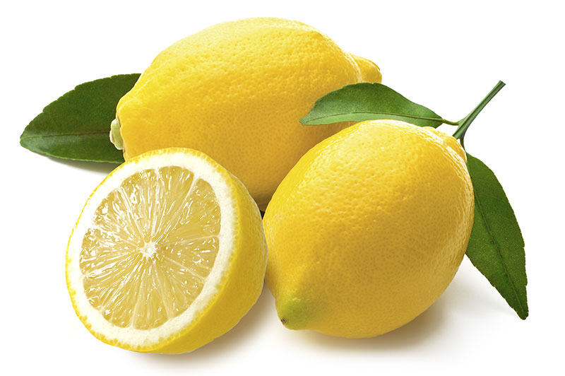
Practice Problems Part 2
1. What are the mean and variance of a Binomial distribution with n=20 and p=0.4?
2. A company purchases large shipments of lemons and uses this acceptance sampling plan: randomly selects 500 lemons, then accepts the whole batch if there is less than two found to be rotten bitter; that is at most one lemon is bad. If a particular shipment actually has a 1.5% rate of defects
a) Using the Binomial probability distribution, what is the probability that the whole shipment is accepted?
b) What is the expected value of the number of bad lemons?
c) What is the standard deviation of the number of bad lemons?
3. White mice are used to evaluate the effectiveness of a certain drug. If only 50% of the mice react to the drug, how many mice should be used to ensure that at least one of the mice will give an observable reaction with a probability of at least 0.95?
Notes:
Answers are provided in Ch4 Practice Problem Solutions.

Slide 16
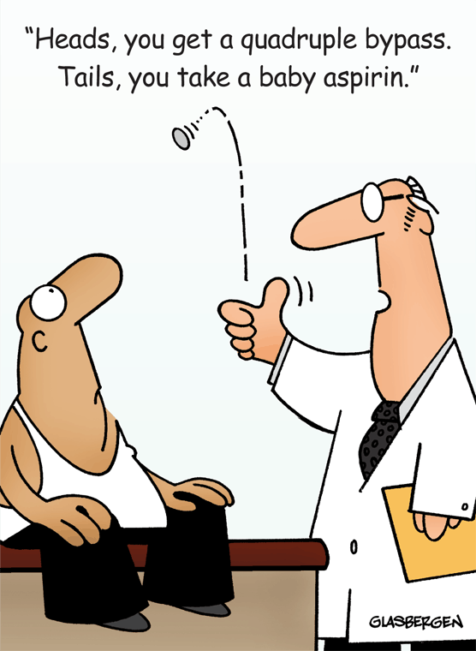
Practice Problems Part 2
4. It was claimed that 1 out of 5 cardiologists takes an aspirin a day to prevent hardening of the arteries. If 15 cardiologists are independently selected, find the probability that
a) more than 2 but less than 5 cardiologists take aspirin
b) more than 3 cardiologists take aspirin
c) exactly 4 cardiologists take aspirin
5. Researchers estimate the rate of preventable adverse drug events (ADE) in hospitals to be 35%. Preventable ADE's typically result from inappropriate care or medication errors. Suppose that 10 hospital patients experiencing an ADE are chosen at random. What is the probability that
a) exactly seven of those adverse drug events were preventable?
b) more than half of those adverse drug events were preventable?
c) least 3 but no more than 8 of those adverse drug events were preventable?
Notes:
Answers are provided in Ch4 Practice Problem Solutions. More examples can be find in the following websites.
Binomial Probability:
http://www.intmath.com/counting-probability/12-binomial-probability-distributions.php
Binomial Distribution Calculator:
http://homepage.stat.uiowa.edu/~mbognar/applets/bin.html

